Slide 1
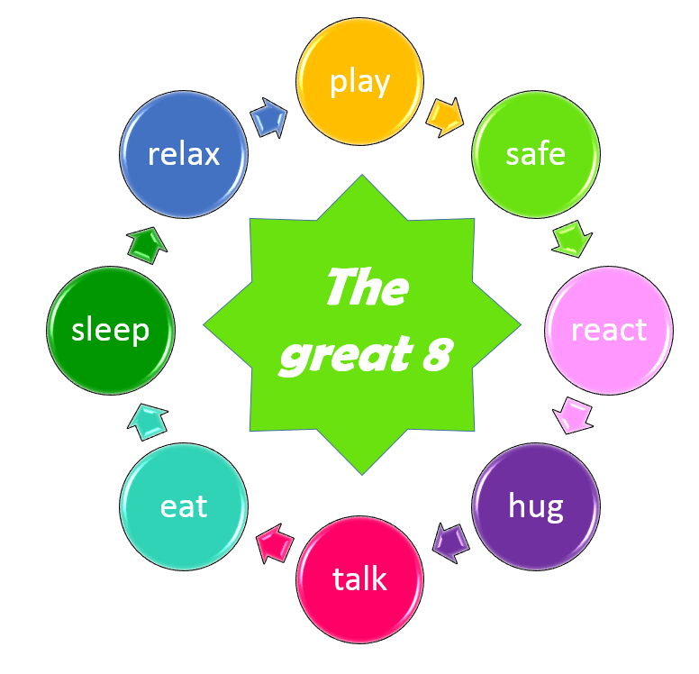
8 things you do every day with your child,
but never knew how powerful they were!

